Slide 1
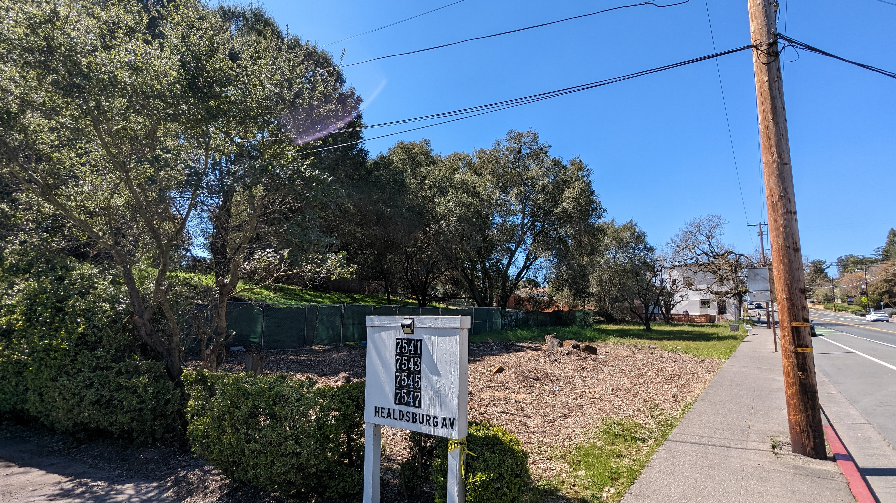
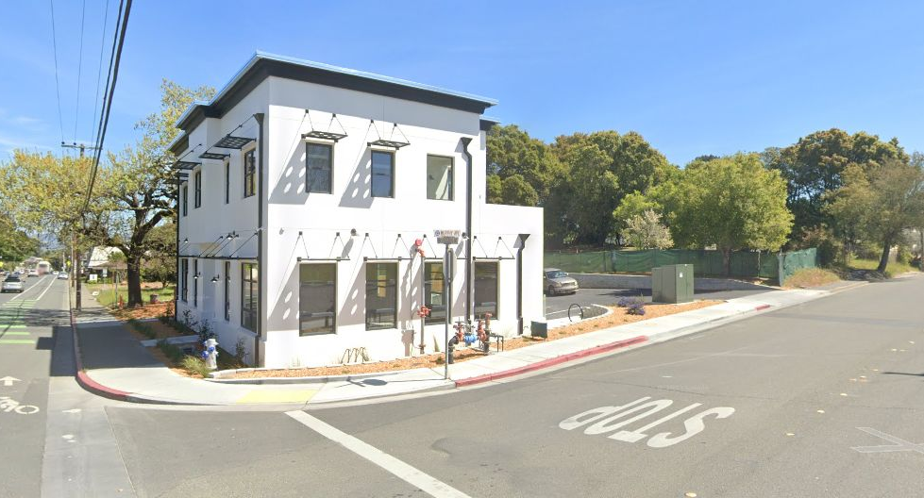
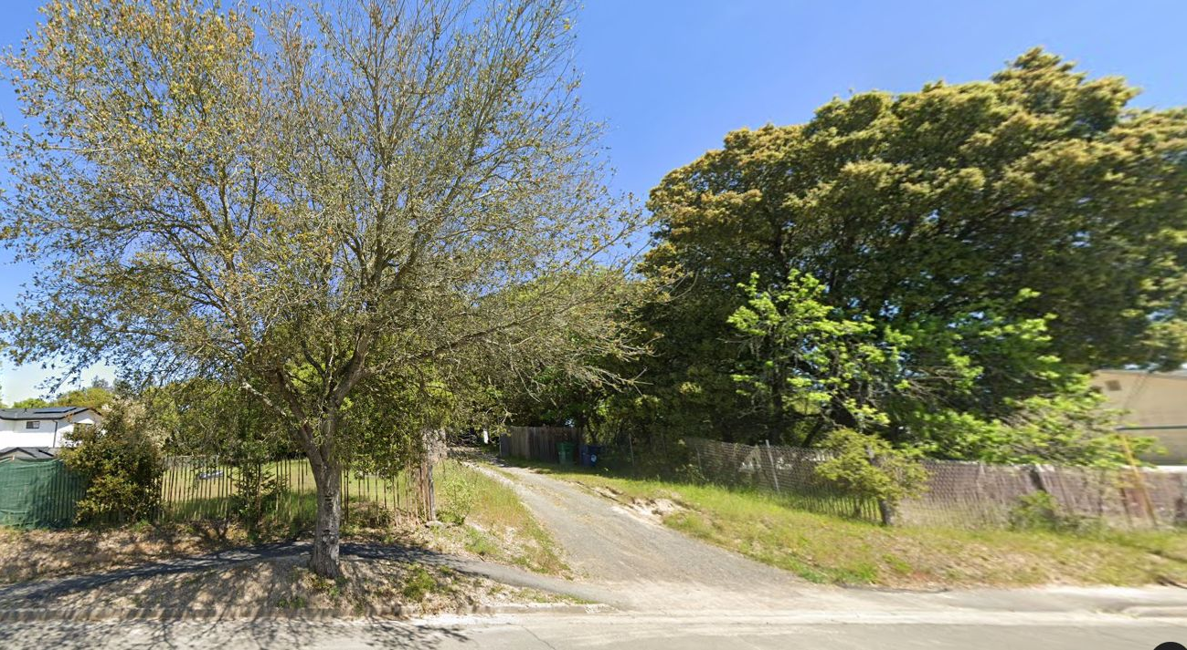
Pacific Knolls
7621 Healdsburg Ave.
The site from east on Healdsburg Ave.
West from corner with Murphy Ave.
Murphy Ave. existing driveway
Katherine Austin, AIA, Architect
Pacific Realty Development LLC
1
2
3

Slide 2
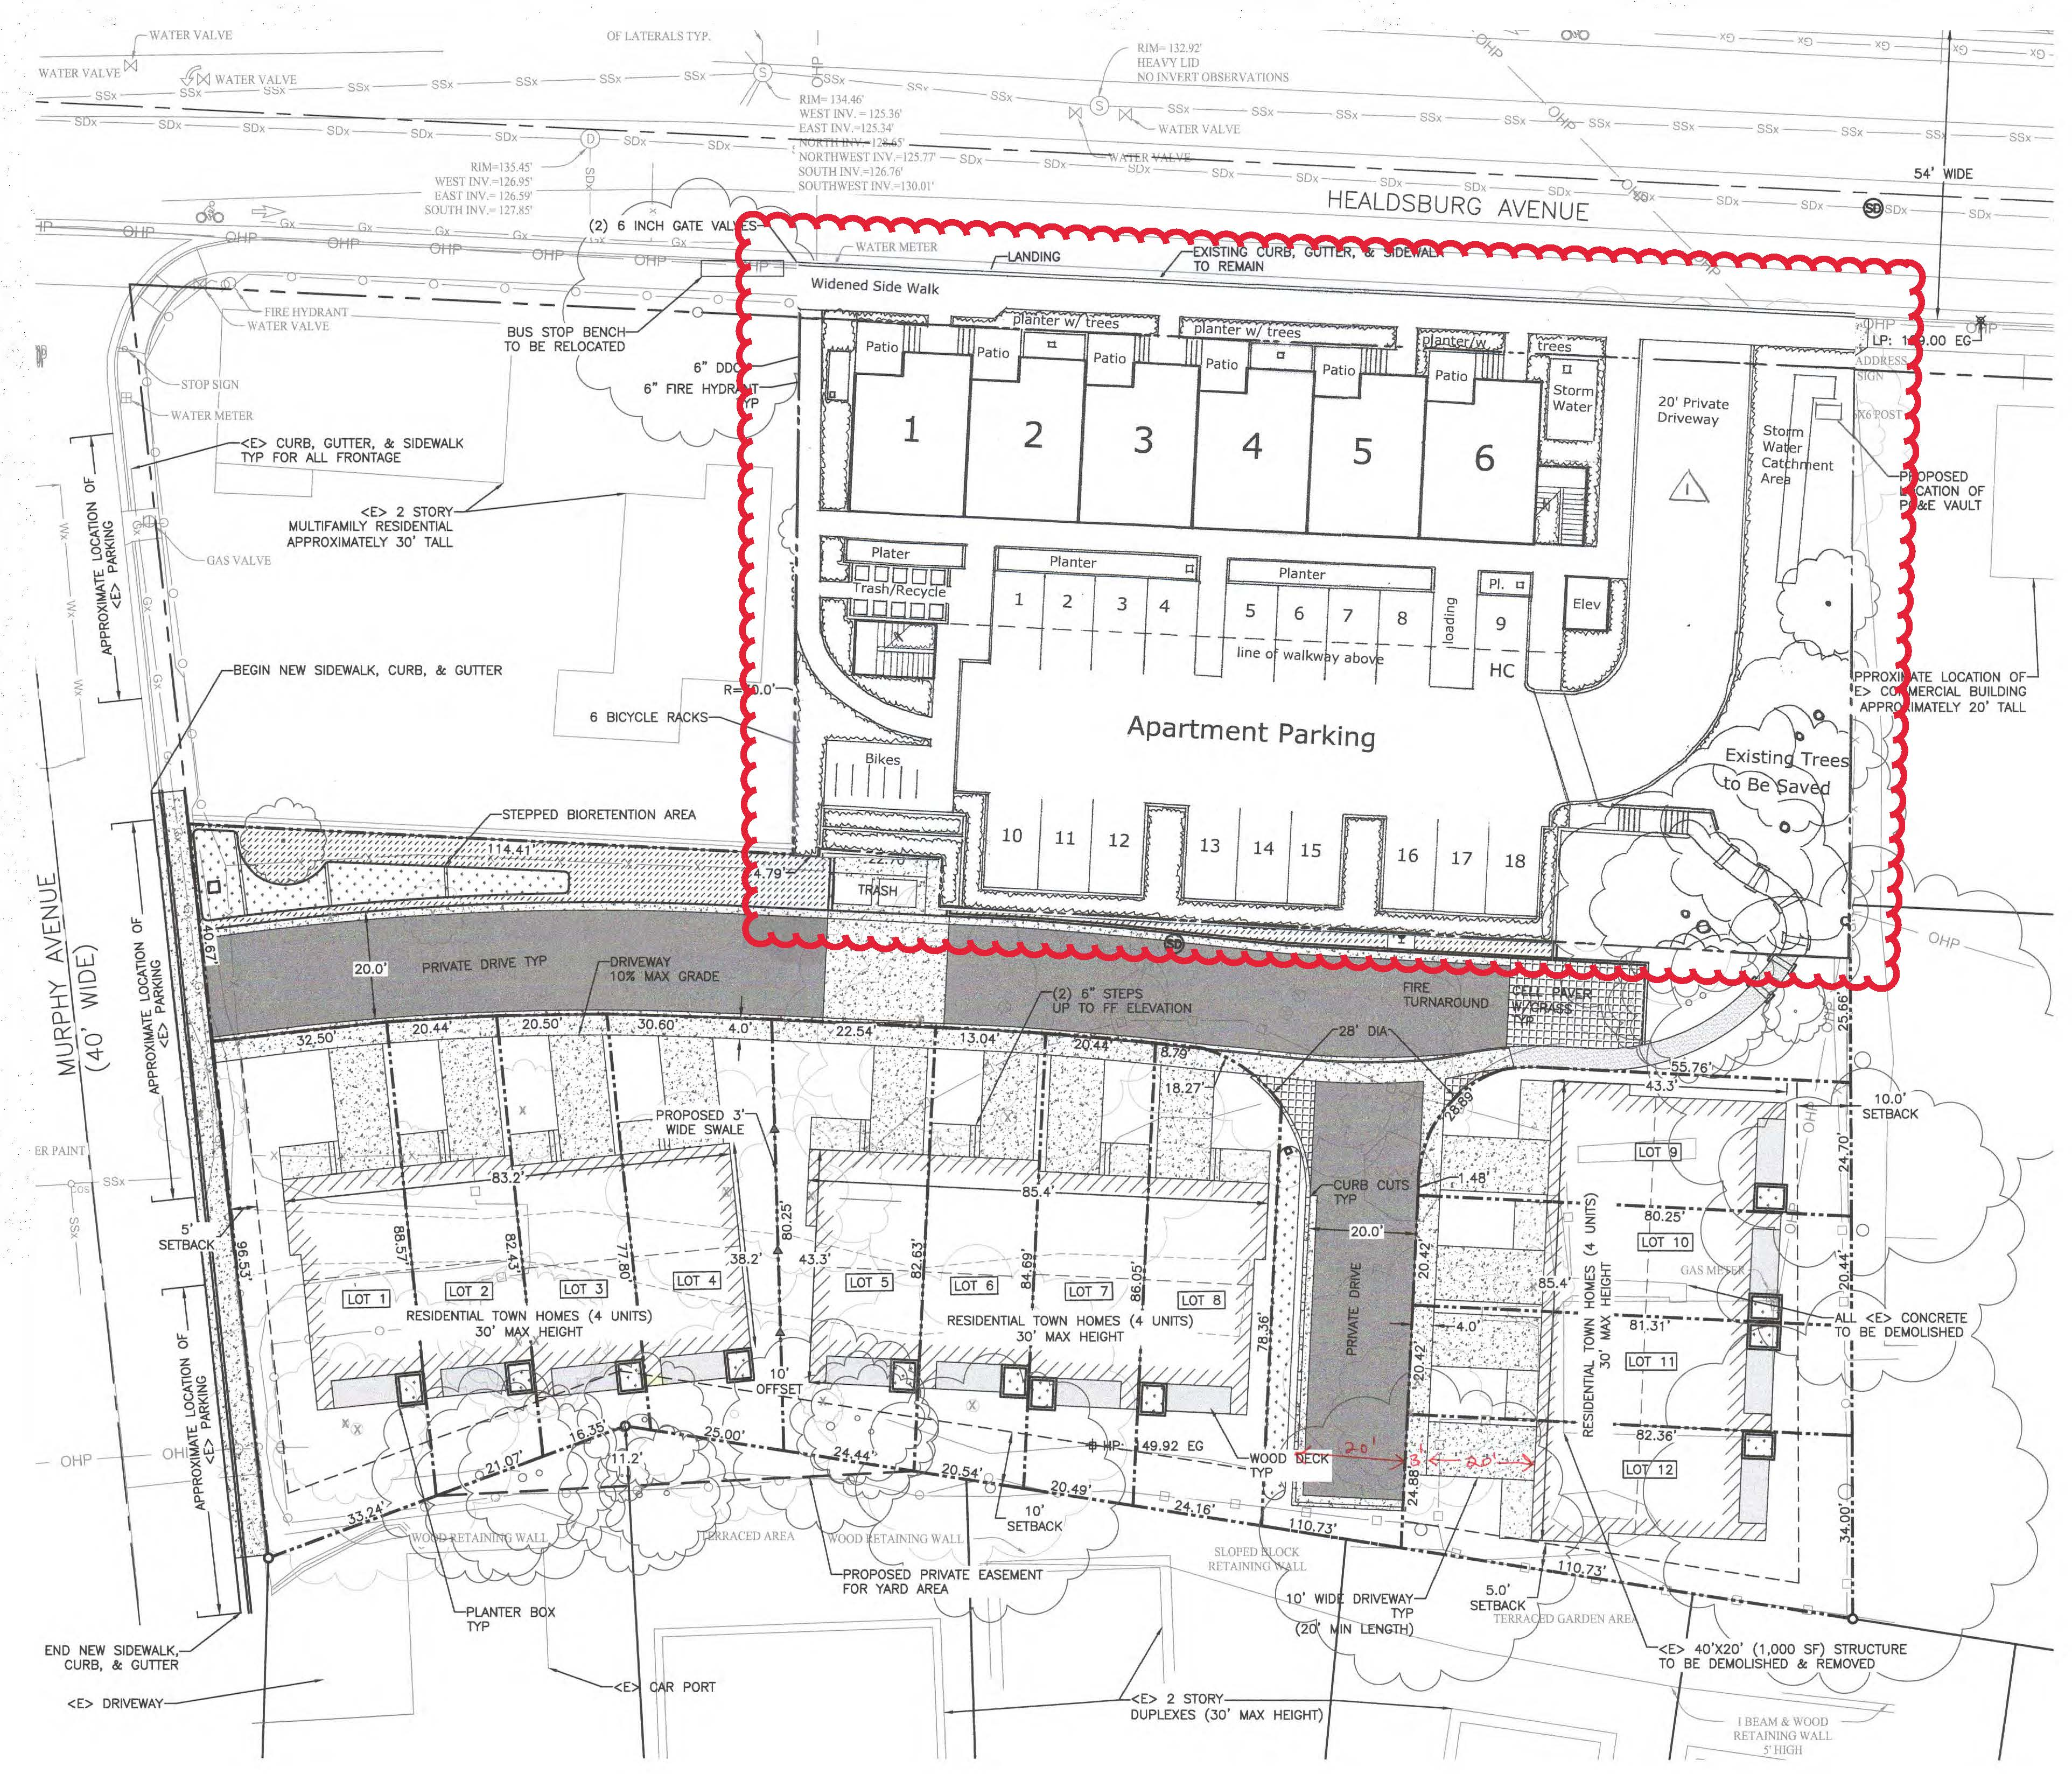
To the left is the proposed revised version with the entry driveway on the east per the traffic study recommendation.
To the right was the originally proposed plan with the driveway on the west as recommended by the previous planning director Kari Svanstrom.

Slide 3
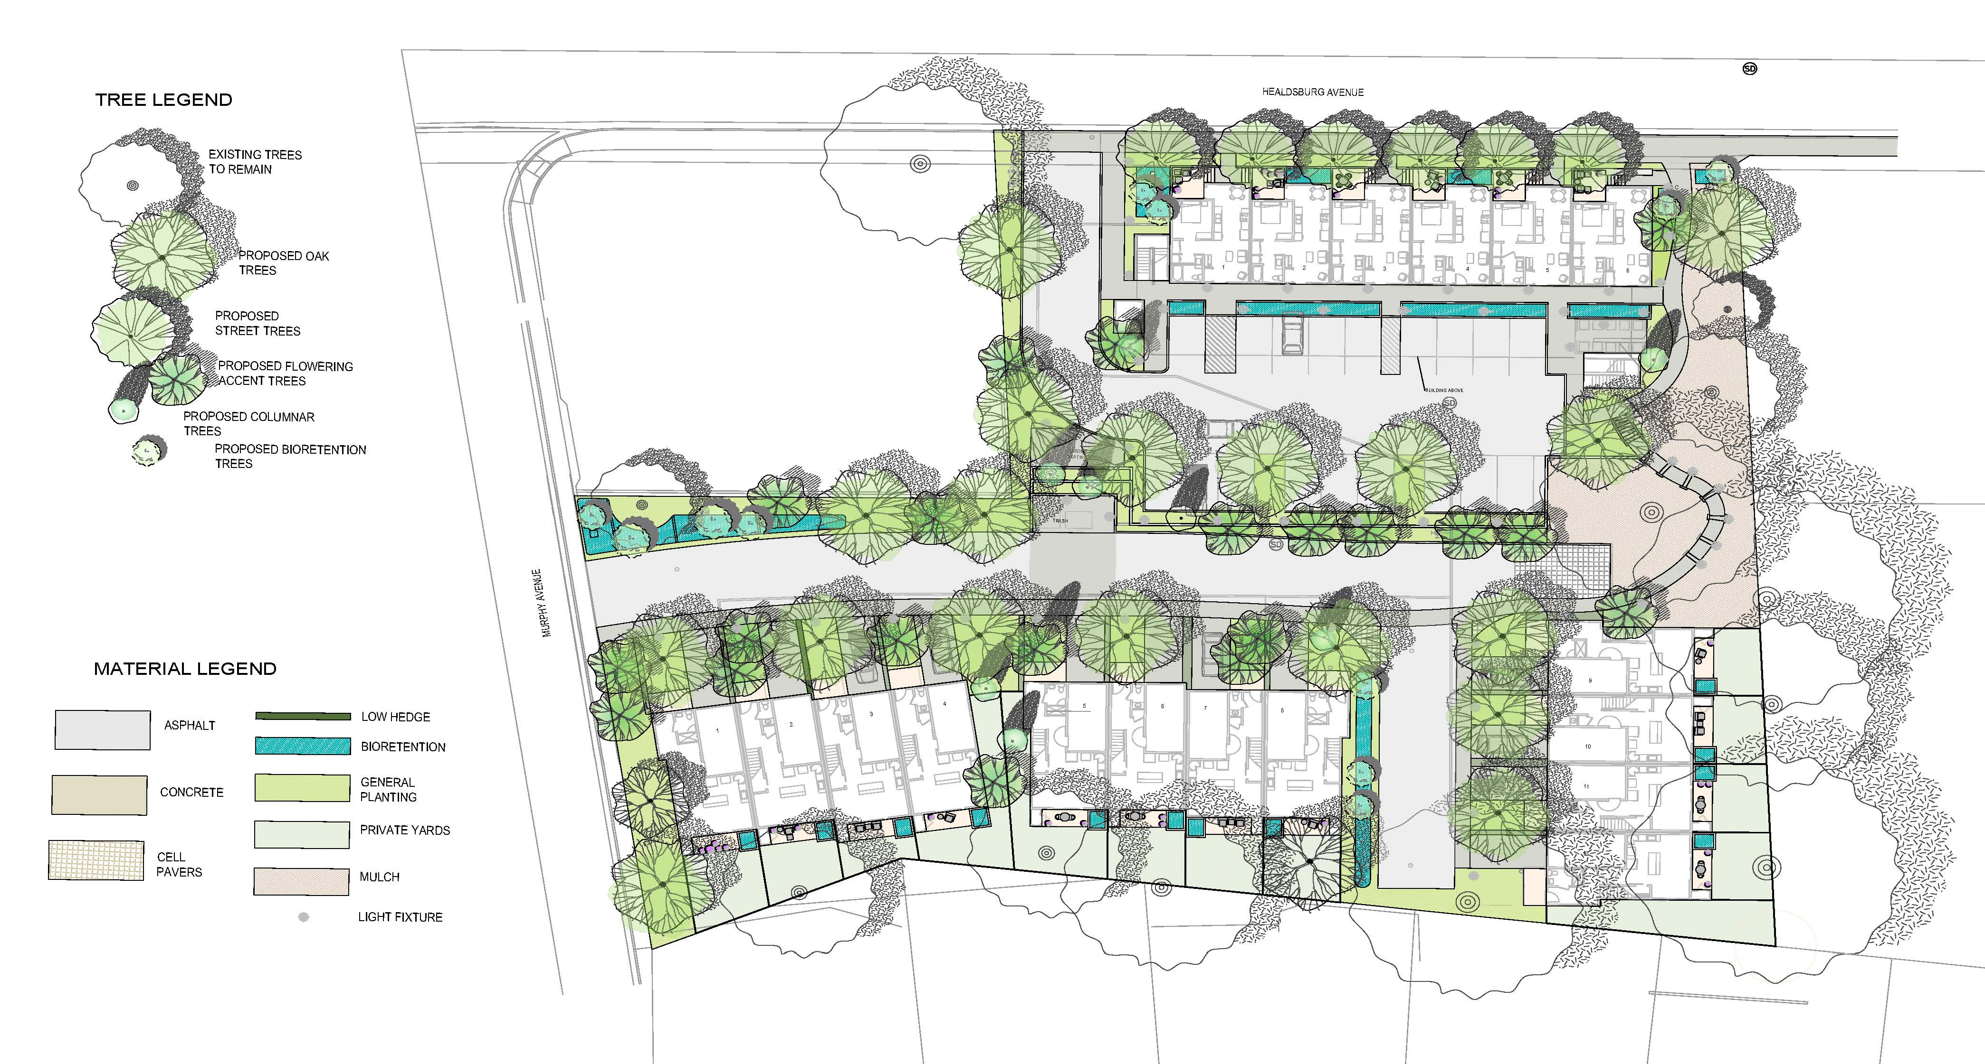
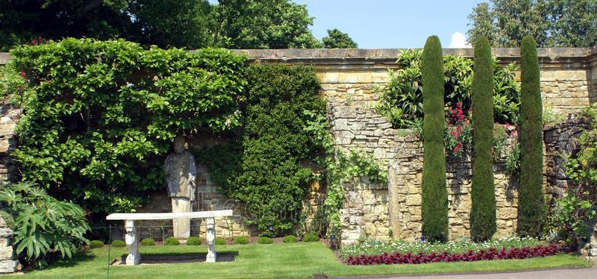

Slide 4
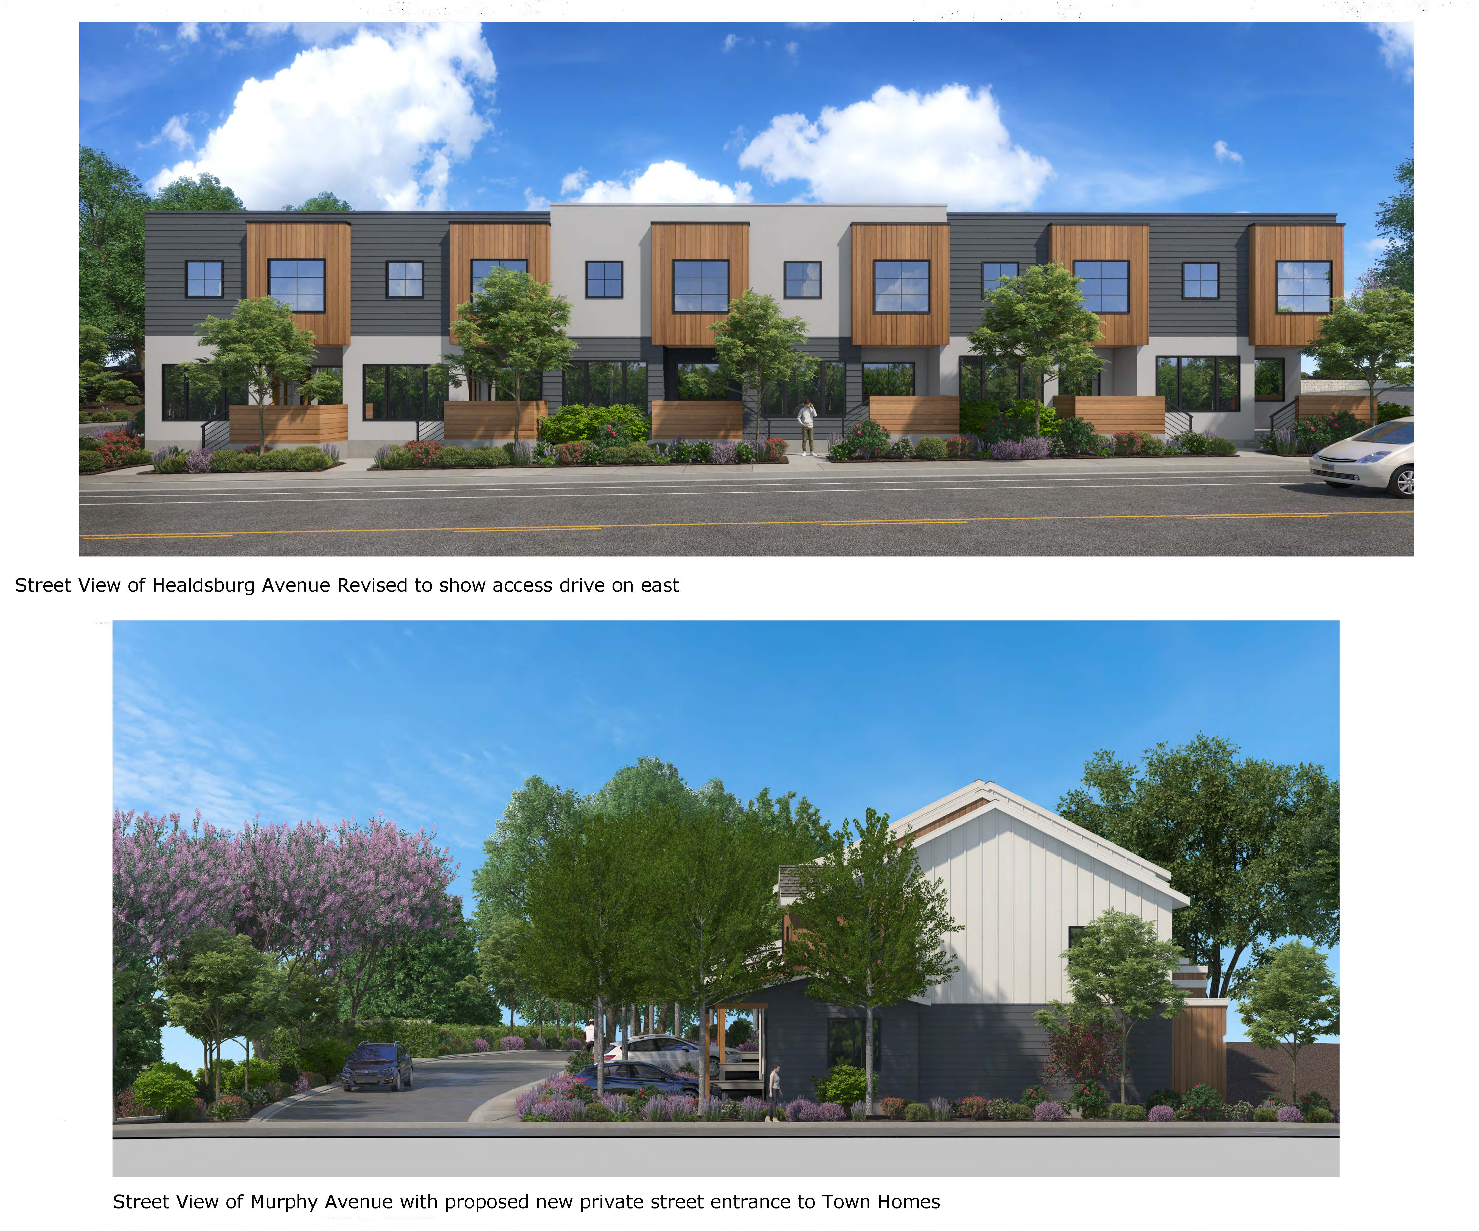

Slide 5
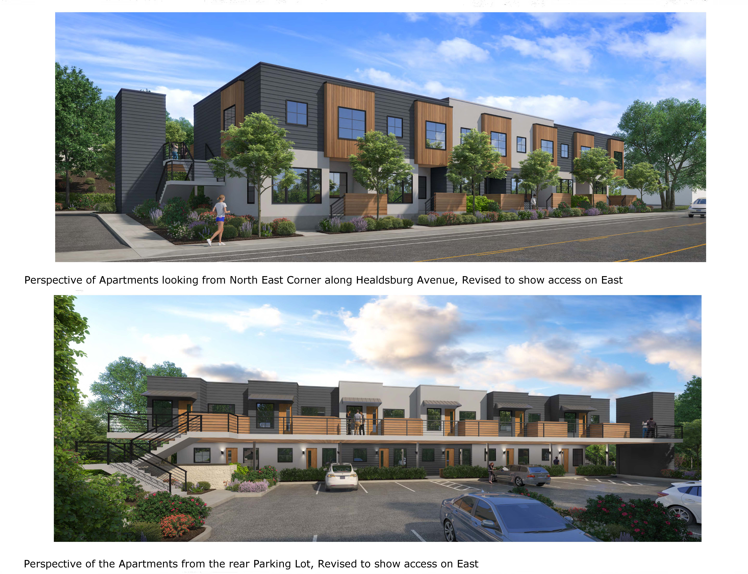

Slide 6
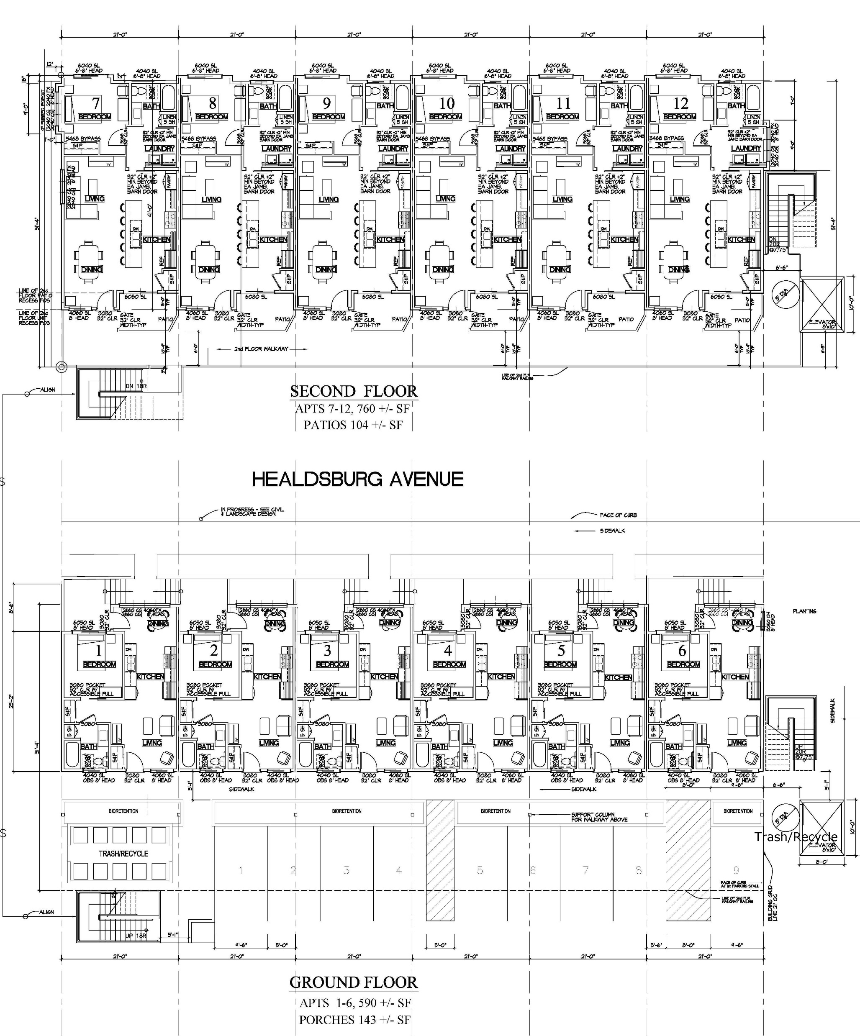
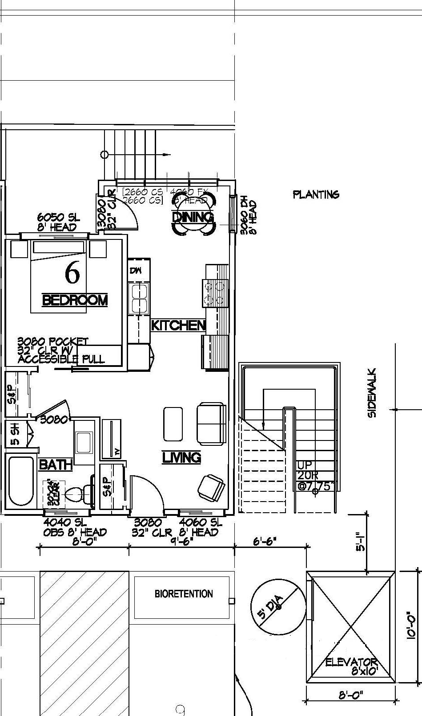
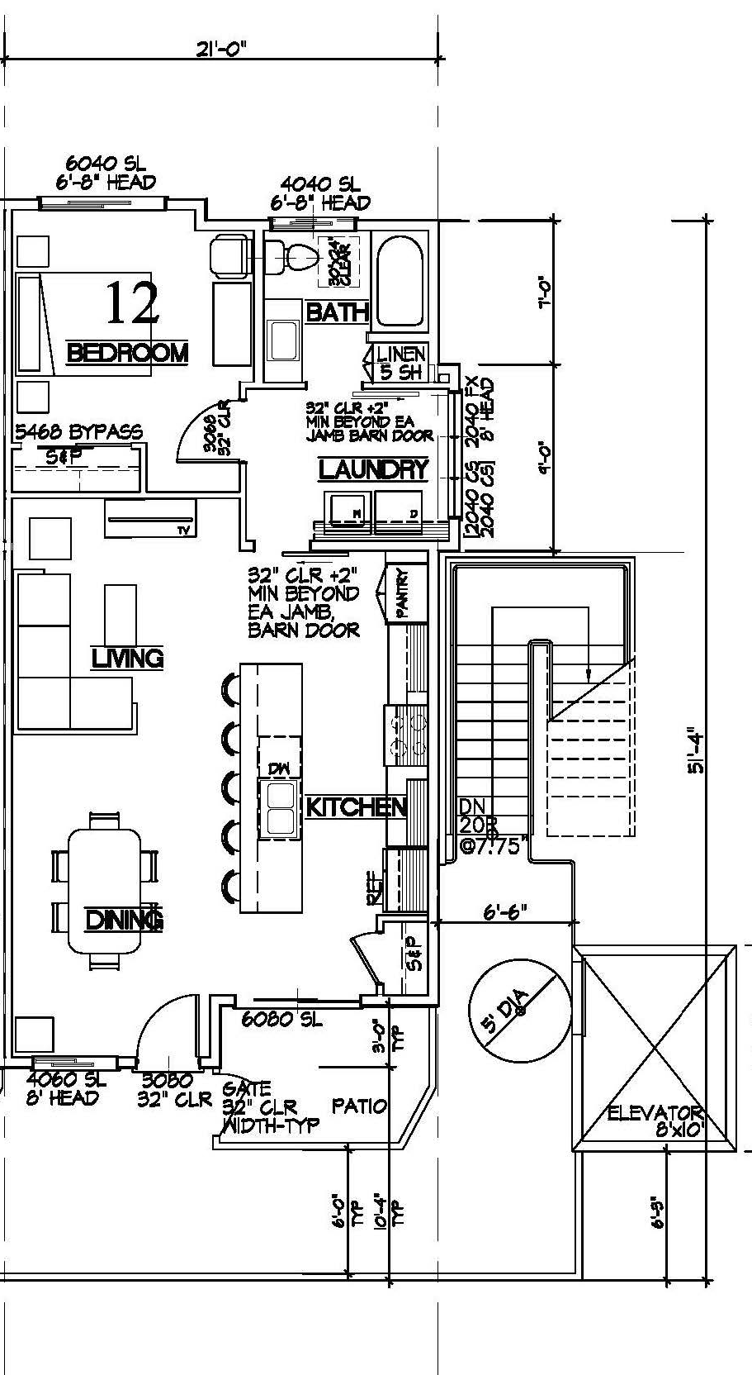
Upper Floor Units 740 SF Lower Floor Units 590 SF
Patio 104 SF Porch 143 SF
Porch

Slide 7
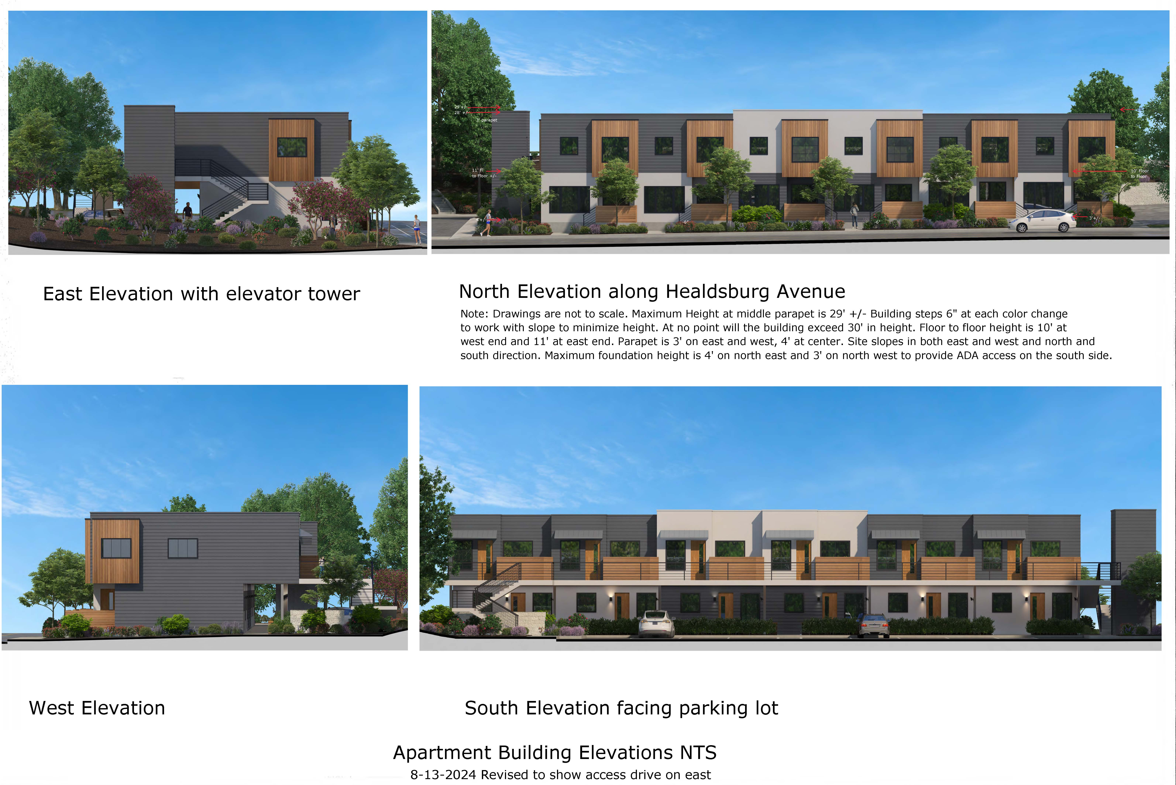
Revised Apartments
Driveway on East

Slide 8
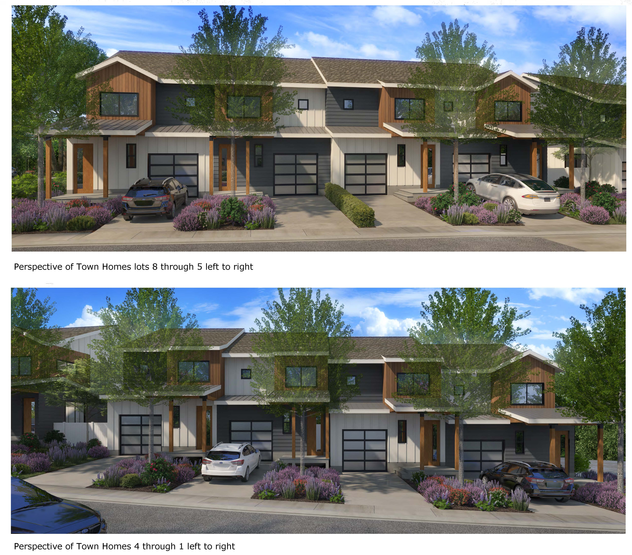
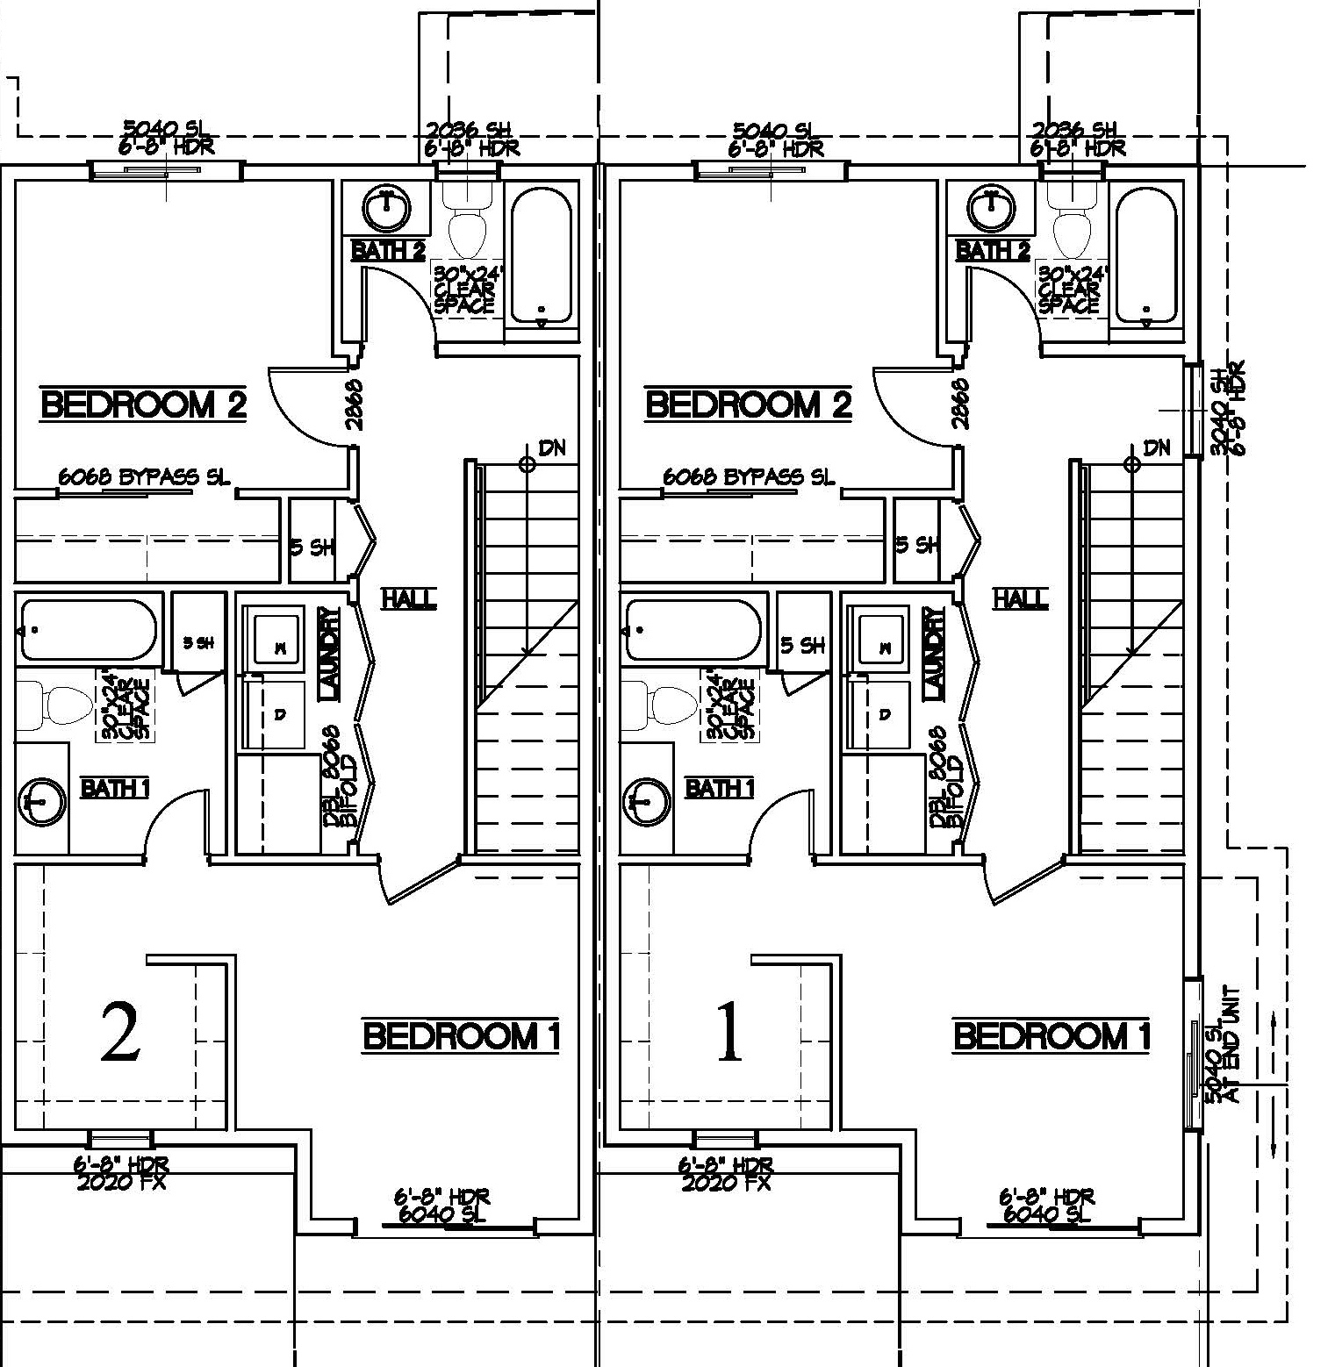
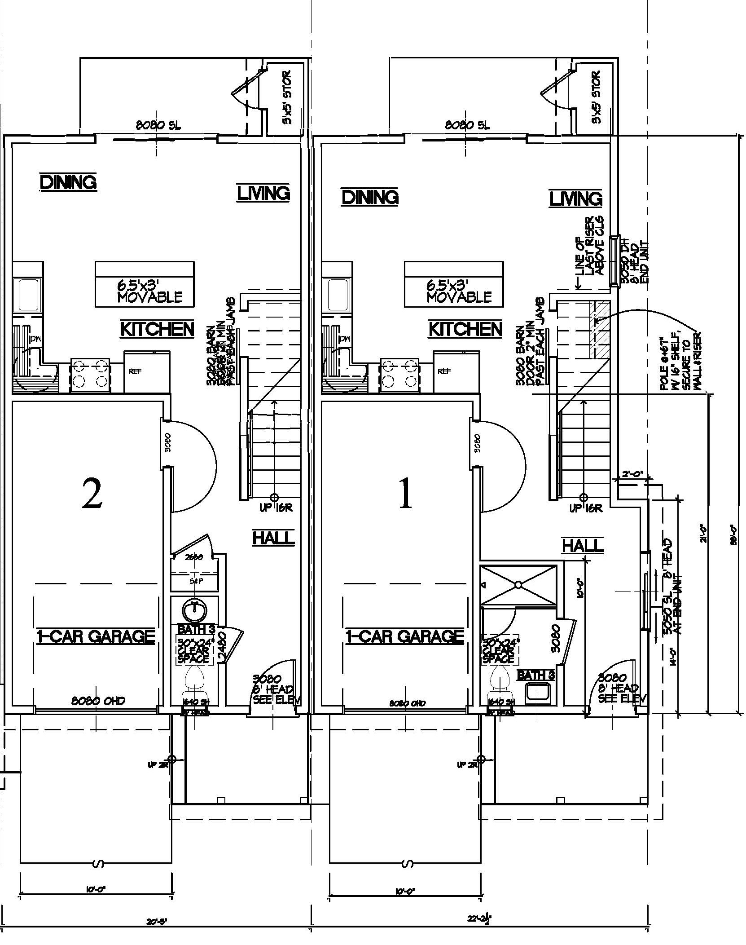

Slide 9
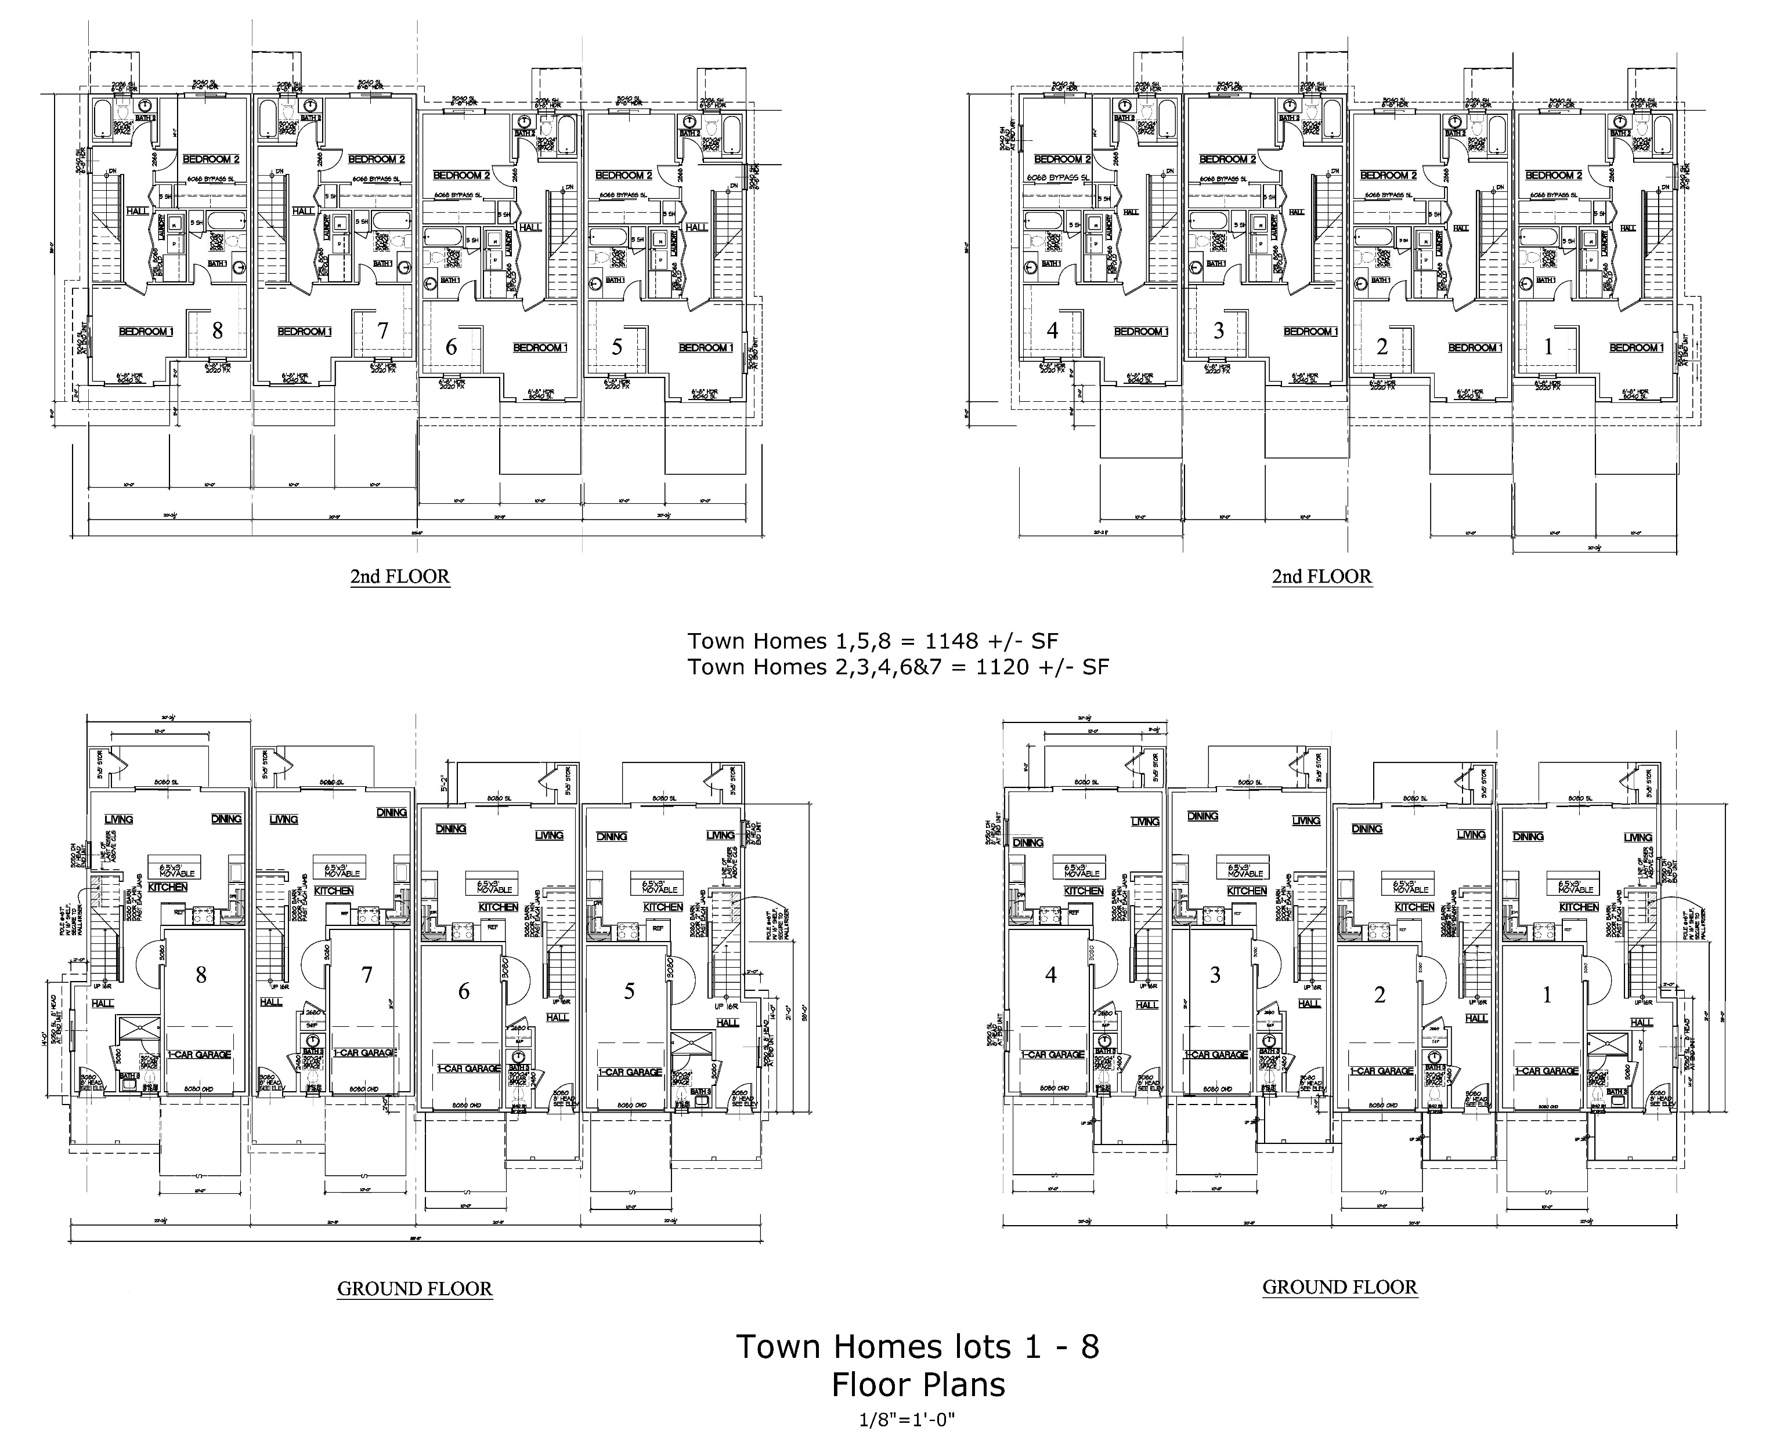
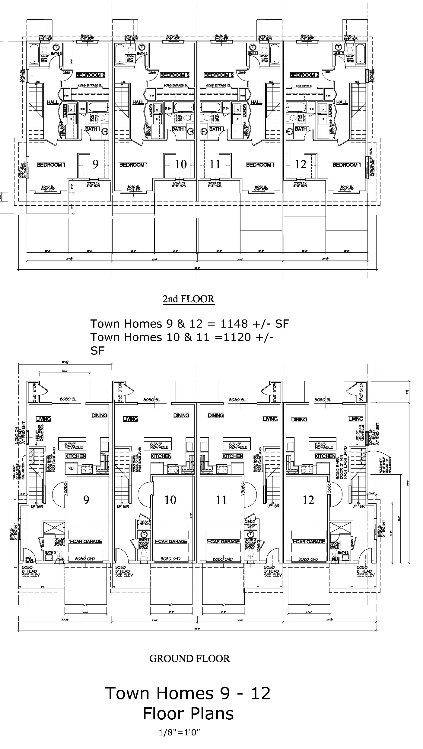

Slide 10
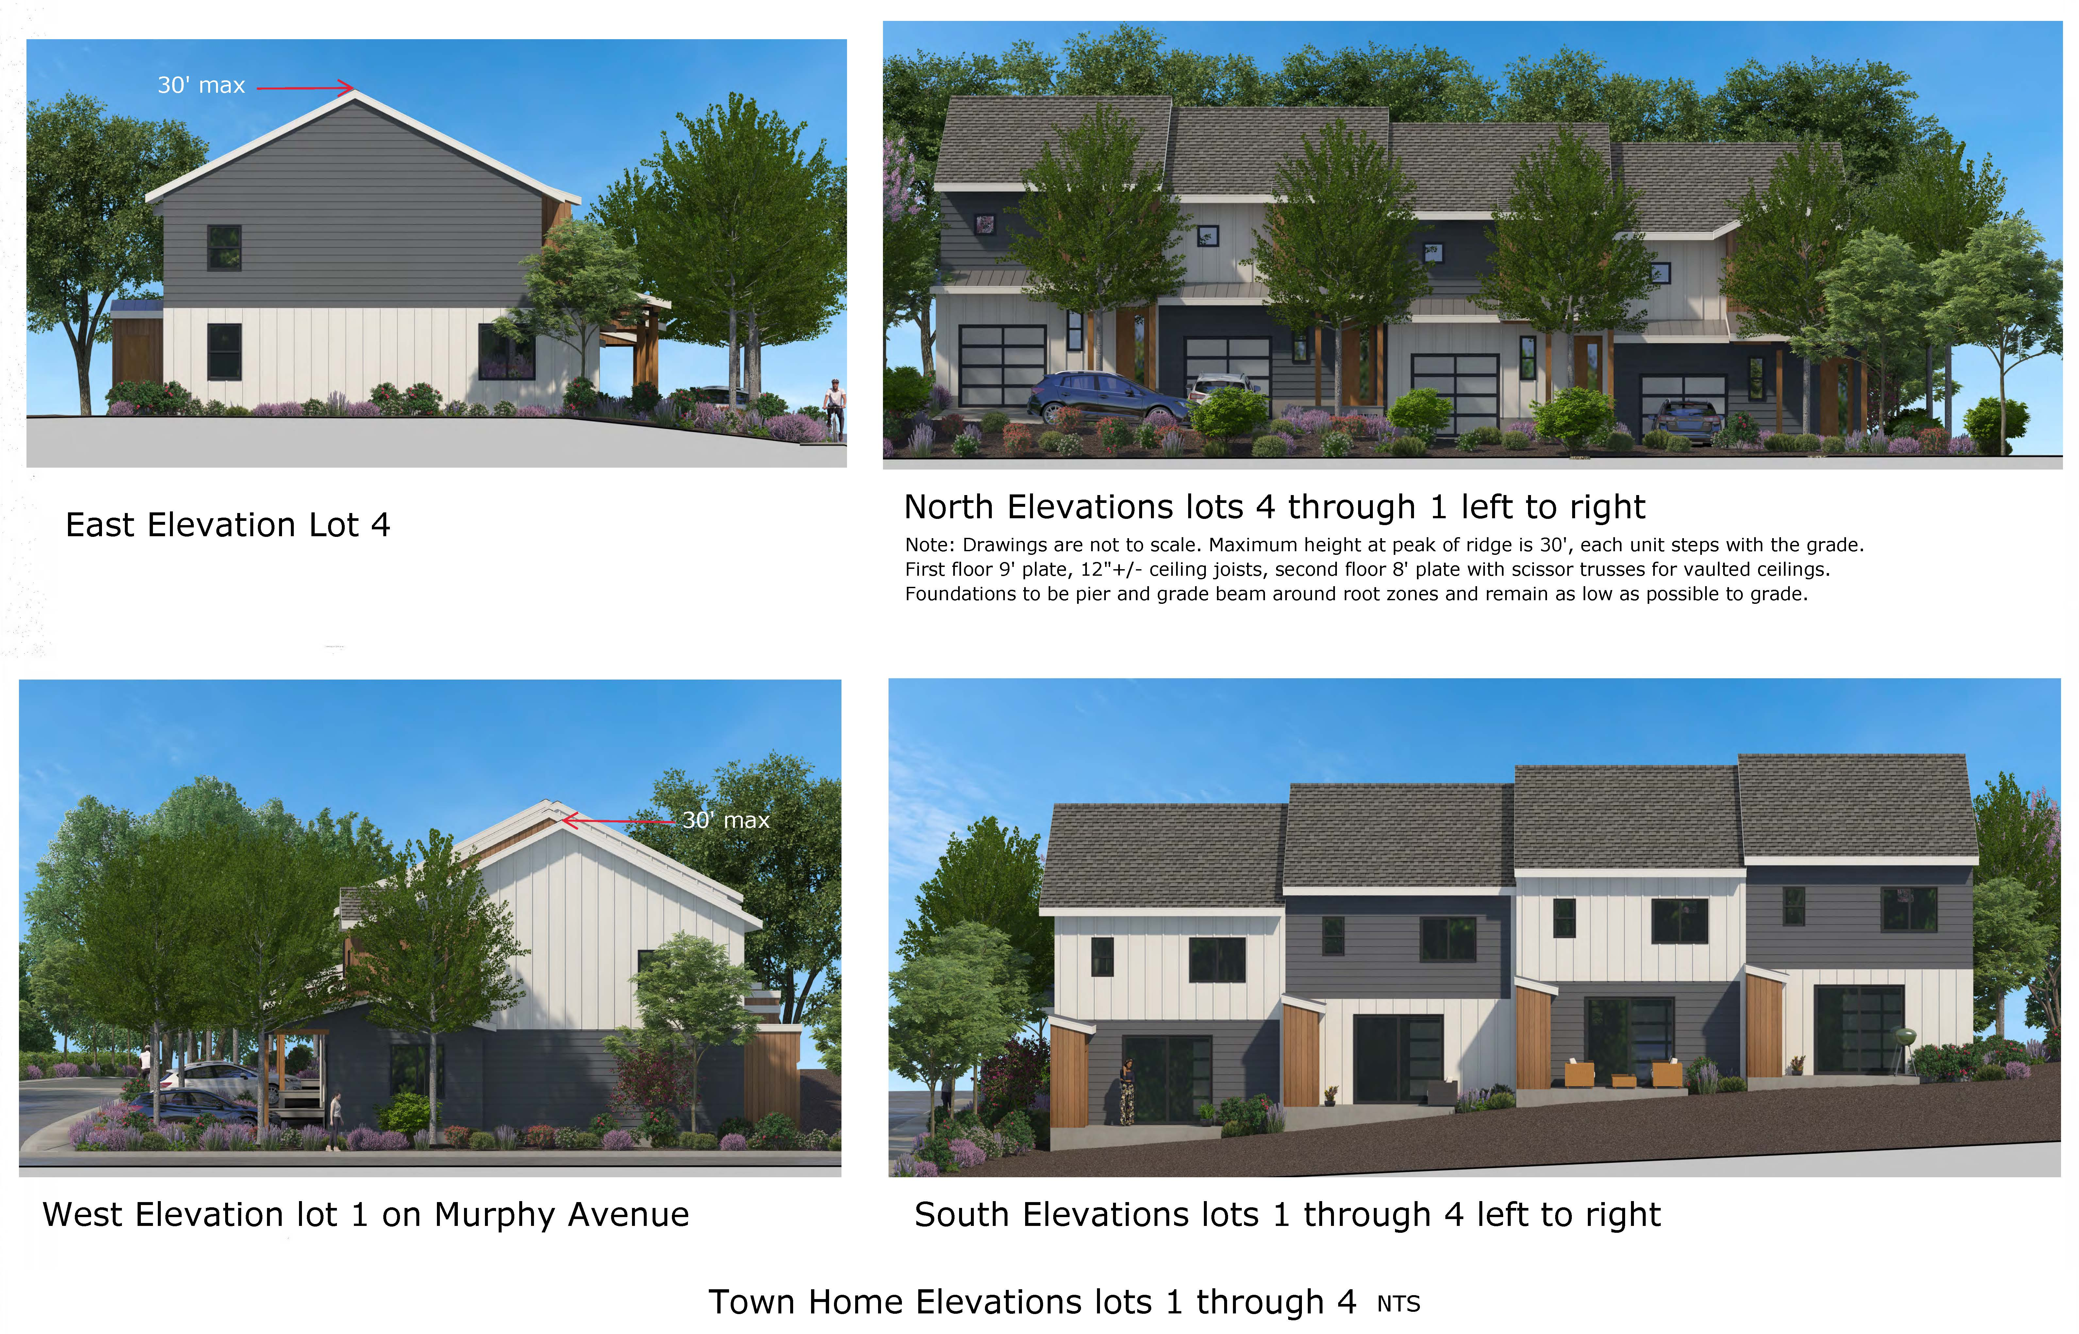

Slide 11
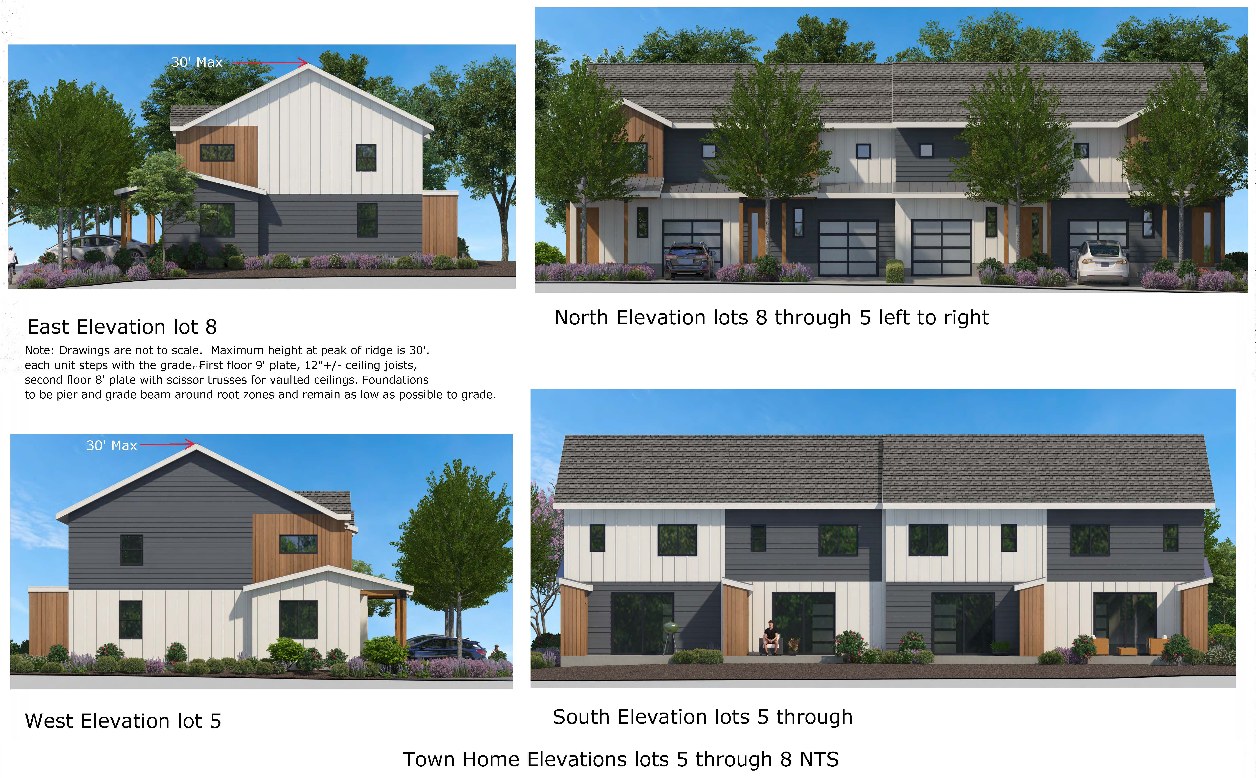

Slide 12
