Slide 1
The people have spoken! (and continue to speak)
Sebastopol Climate Action Committee report to City Council
October 5, 2022

Slide 2
Climate Action Framework
Extensive public engagement process
Appendix contains the details of what actions could move Sebastopol toward carbon neutrality
CAC prioritizing actions on basis of impact and feasibility

Slide 3
How do we get there?

Slide 4
Upcoming: electrification survey
Energy working group project

Slide 5
We want clean energy!
Outreach to other organizations (AIA, green building council, RCPA ) to try to initiate a green building tour next spring, somewhat on the model of garden tours, to get people excited about upgrading their buildings.
Recommendations on changes to the municipal code to provide enforceable and clear green building and energy sections.
Energy working group meetings with Sonoma Clean Power, PG&E and other Sonoma County communities to explore how to introduce community energy.

Slide 6
What is community energy?
Local production
Local storage
Local control
Local benefits

Slide 7
We want resilience!
There is an emerging physical distribution problem that is worrying the utilities.
PG&E does have a microgrid effort and recognizes changes are required.
Sonoma Clean Power is looking at how we can take advantage of all the solar we currently get without having to transmit it back to PG&E.
Current tariff structures and regulations protect the regulated monopolies' business, making community energy financially unfavorable (need for more engagement from municipal officials).
Need for more creative ways to increase EV daytime charging when solar power production is highest.

Slide 8
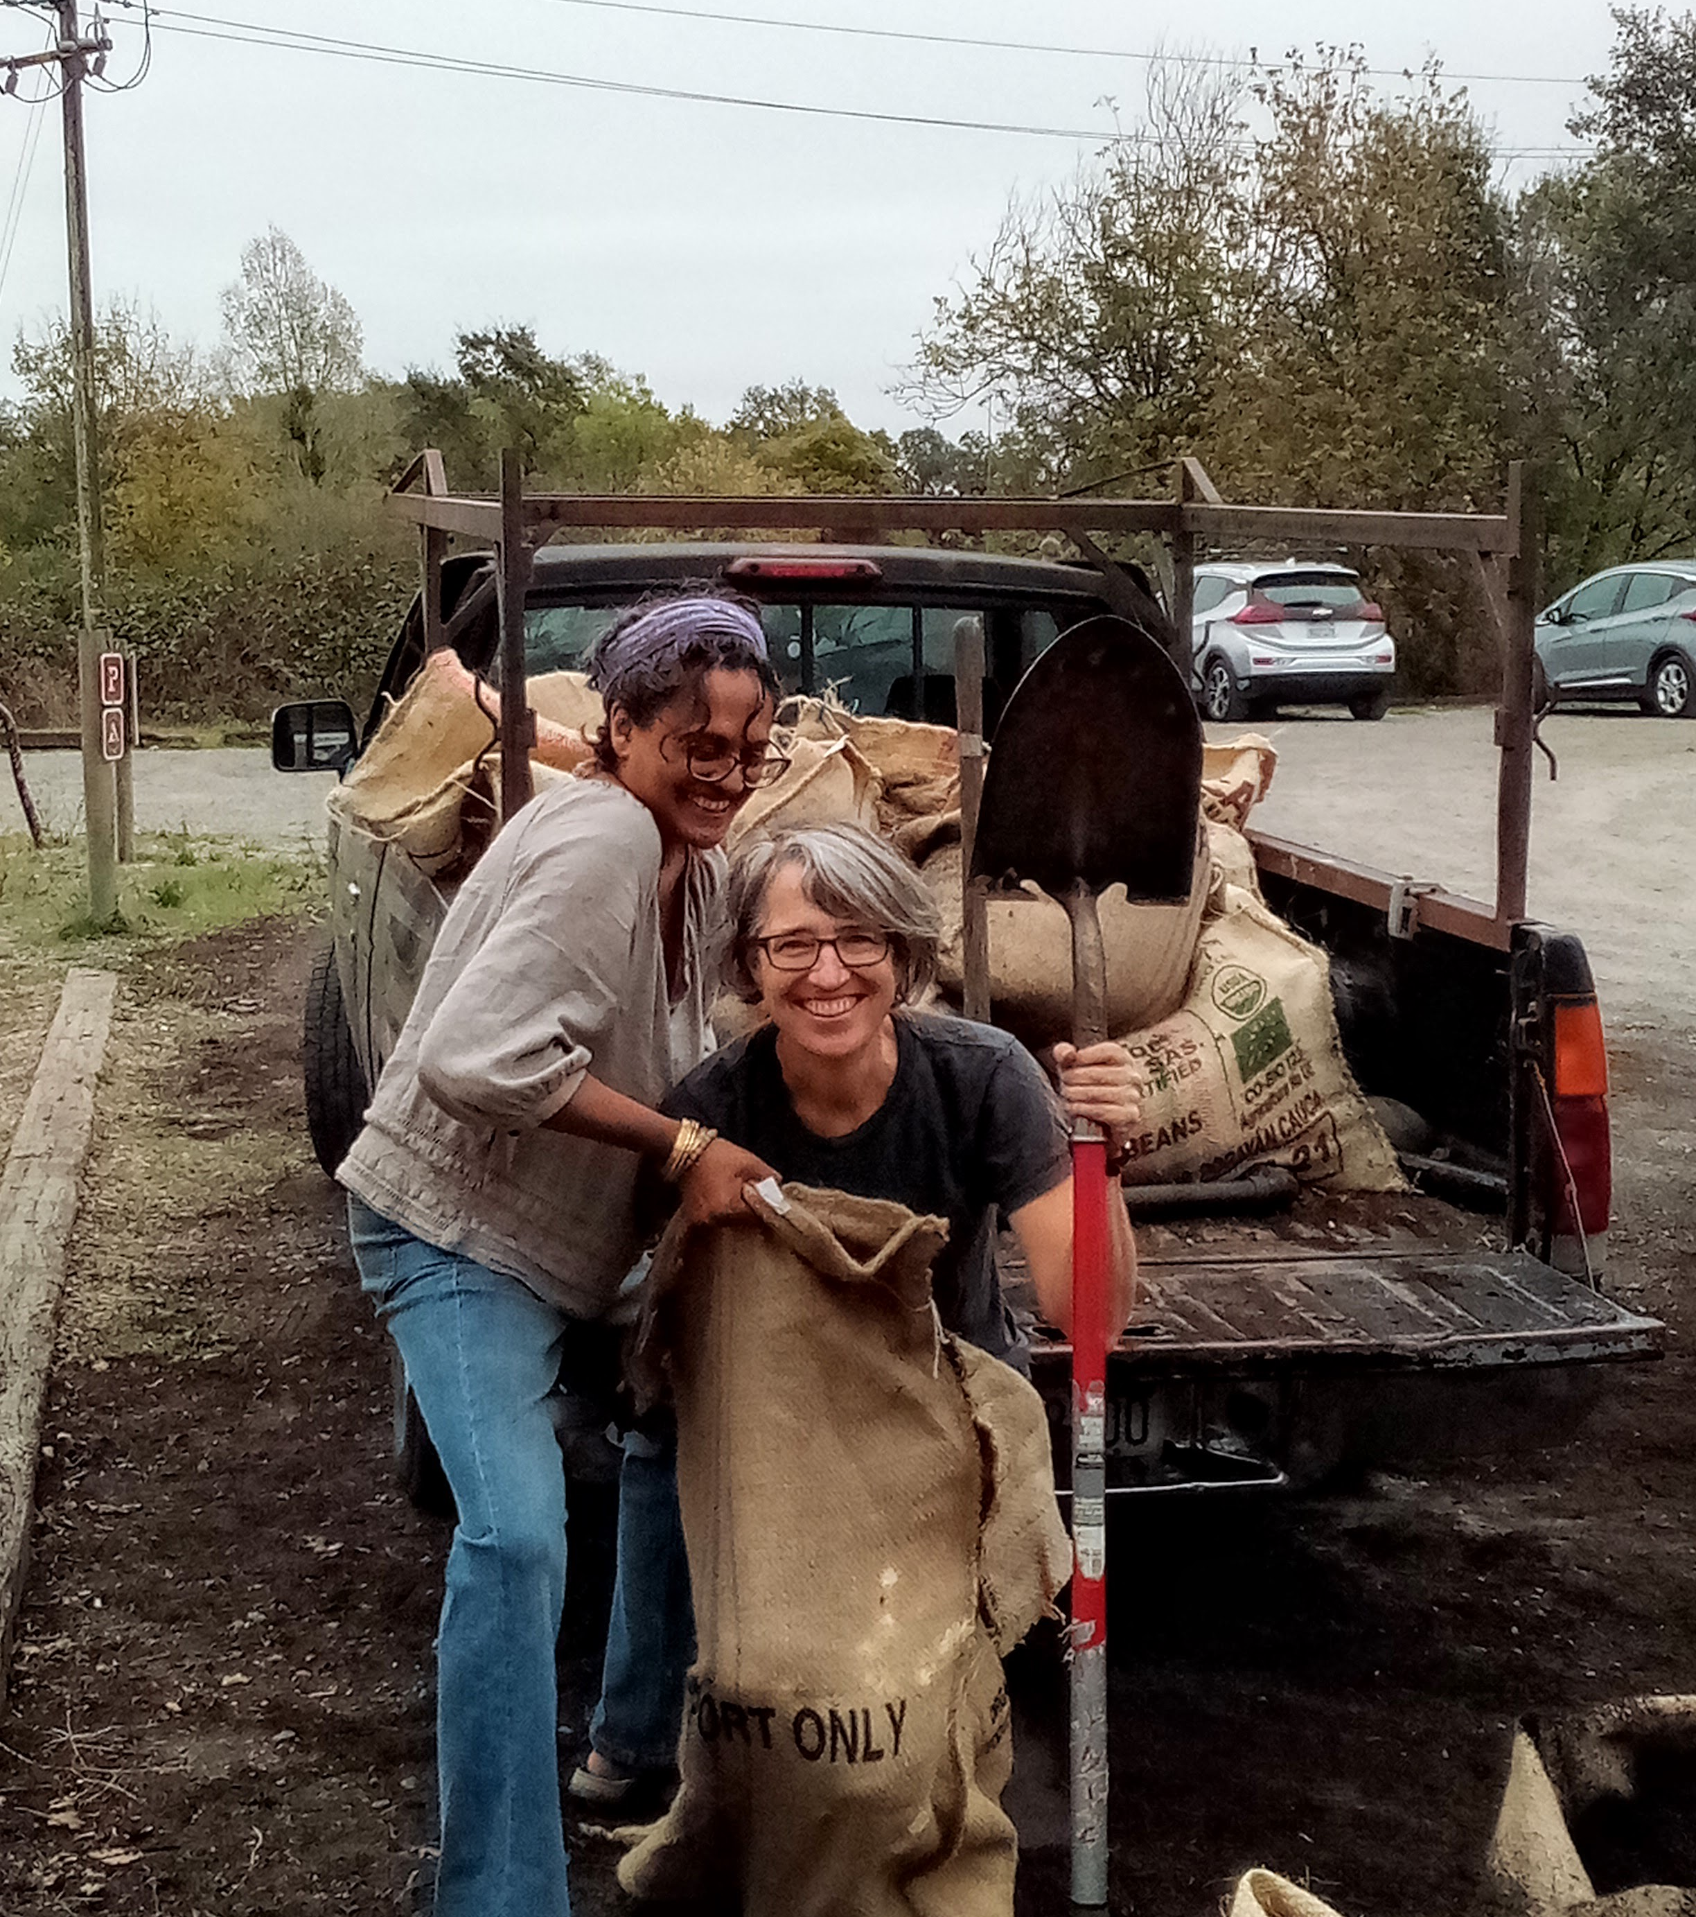
What next?
CAC will develop a work plan for the next 12 months at the October 26 meeting.
So much more! We’ll be back.
Seats open! Looking for a few new members…

Slide 9
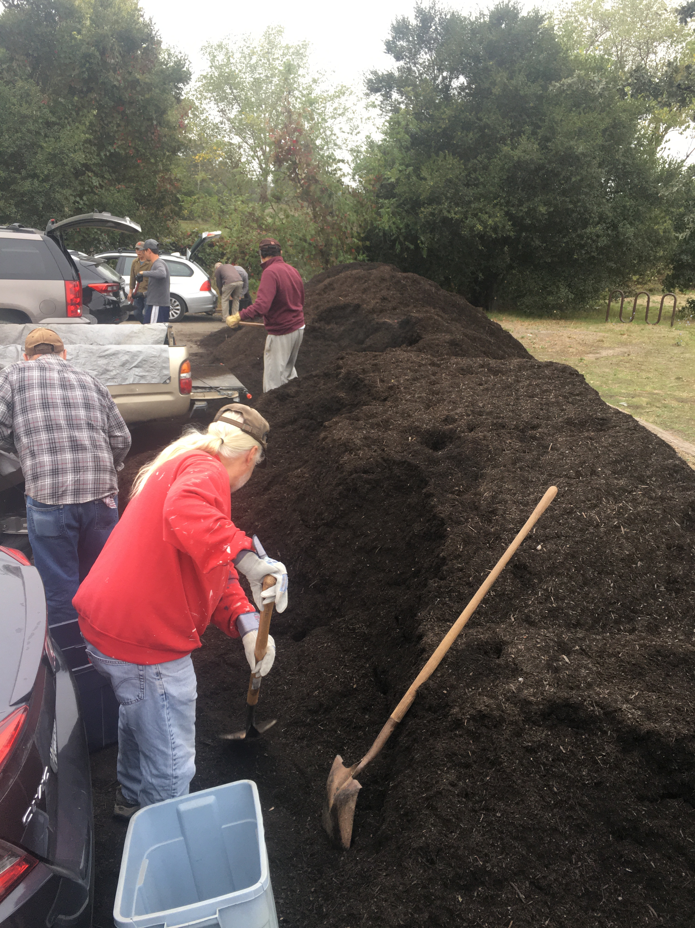
Thank you so much for doing the compost events!
“My trees are going to be so happy"
"My vegetables have been doing so well since the compost from the last give away"
"Fall gardeners are the best! So polite and nice"

